Slide 1
Orbit Propagation to Determine Satellite’s Demise
Jacob Bailey
Gus Lee
Michael Lesnewski

Slide 2
Problem Statement
Objective:
Propagate the orbit of the Tiangong 1 Chinese space station and estimate the lifetime of the space station using both numerical integration of the Keplarian equations of motion including J2 and atmospheric drag perturbations and the averaged Gauss variational equations.
The lifetime of the space station will be determined when the magnitude of the orbital position vector is less than the equatorial radius of the Earth.

Slide 3

Initial Conditions for Orbit Propagation
$\left[\begin{matrix}\begin{matrix}a \\ e \\ i\end{matrix} \\ \begin{matrix}Ω \\ ω \\ f\end{matrix}\end{matrix}\right]=\left[\begin{matrix}\begin{matrix}6657.391 \\ .002594 \\ 42.7480\end{matrix} \\ \begin{matrix}345.3258 \\ 124.4125 \\ 287.3948\end{matrix}\end{matrix}\right]$ $\left[\begin{matrix}r \\ v\end{matrix}\right]=\left[\begin{matrix}\begin{matrix} \\ \\ \end{matrix} \\ \begin{matrix} \\ \\ \end{matrix}\end{matrix}\right]$
Epoch Time:
JD = 2458130.58298365

Slide 4
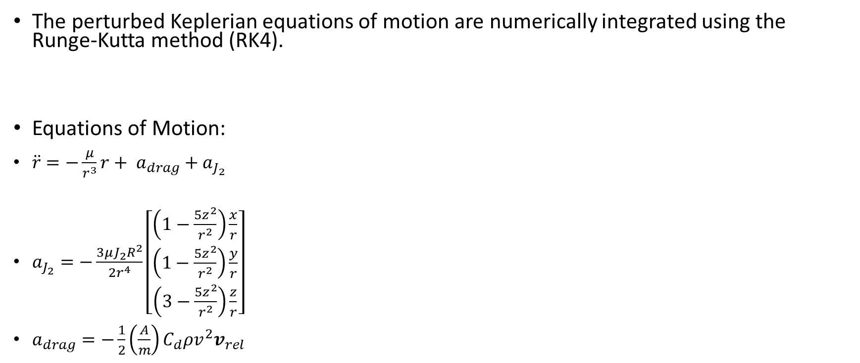
Orbit Propagation using Numerical Integration
The perturbed Keplerian equations of motion are numerically integrated using the Runge-Kutta method (RK4).
Equations of Motion:
$\ddot{r}=−\frac{μ}{r^{3}}r+ a_{drag}+a_{J_{2}}$
$a_{J_{2}}=−\frac{3μJ_{2}R^{2}}{2r^{4}}\left[\begin{matrix}\left(1−\frac{5z^{2}}{r^{2}}\right)\frac{x}{r} \\ \left(1−\frac{5z^{2}}{r^{2}}\right)\frac{y}{r} \\ \left(3−\frac{5z^{2}}{r^{2}}\right)\frac{z}{r}\end{matrix}\right]$
$a_{drag}=−\frac{1}{2}\left(\frac{A}{m}\right)C_{d}ρv^{2}v_{rel}$

Slide 5
Results: Numerical Integration

Slide 6

Orbit Propagation using Gauss Variational Equations
Asd
Equations of Motion:
$\dot{\dot{\overline{a}}=−\left(\frac{A}{m}\right)C_{d}na^{2}p_{a}\left\{I_{0}\left(ν\right)+2eI_{1}\left(ν\right)+\frac{3}{4}e^{2}\left[I_{0}\left(ν\right)+I_{2}(ν)\right]\right\}}$
$\dot{\overline{e}}=−\left(\frac{A}{m}\right)C_{d}na\left(1−e^{2}\right)p_{a}\left\{I_{1}\left(ν\right)+\frac{1}{2}e\left[I_{0}\left(ν\right)+I_{2}(ν)\right]+\frac{1}{8}e^{2}\left[3I_{1}\left(ν\right)+I_{3}(ν)\right]\right\}$
$\dot{\overline{Ω}}=−\frac{3J_{2}R^{2}n}{2p^{2}}\cos{i}$
$\dot{\overline{ω}}=\frac{3J_{2}R^{2}n}{4p^{2}}\left(5\cos^{2}{i}−1\right)$

Slide 7
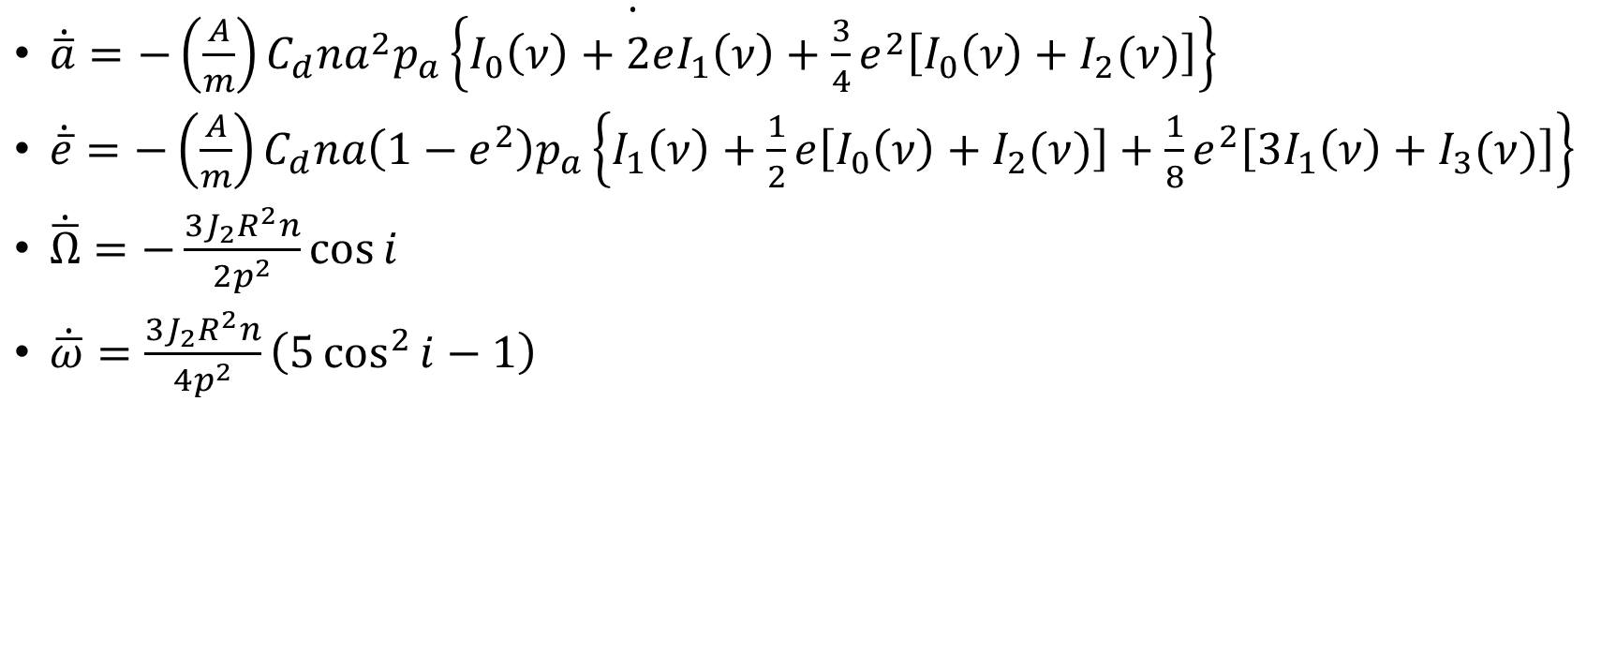
Equations of Motion (Averaged)
$\dot{\dot{\overline{a}}=−\left(\frac{A}{m}\right)C_{d}na^{2}p_{a}\left\{I_{0}\left(ν\right)+2eI_{1}\left(ν\right)+\frac{3}{4}e^{2}\left[I_{0}\left(ν\right)+I_{2}(ν)\right]\right\}}$
$\dot{\overline{e}}=−\left(\frac{A}{m}\right)C_{d}na\left(1−e^{2}\right)p_{a}\left\{I_{1}\left(ν\right)+\frac{1}{2}e\left[I_{0}\left(ν\right)+I_{2}(ν)\right]+\frac{1}{8}e^{2}\left[3I_{1}\left(ν\right)+I_{3}(ν)\right]\right\}$
$\dot{\overline{Ω}}=−\frac{3J_{2}R^{2}n}{2p^{2}}\cos{i}$
$\dot{\overline{ω}}=\frac{3J_{2}R^{2}n}{4p^{2}}\left(5\cos^{2}{i}−1\right)$

Slide 8
Results: Gauss Variational Equations

Slide 9
Conclusion

